Slide 1
Lecture 21:
5.5. South Asia & Middle East
Brad DeLong
Department of Economics & Blum Center, U.C. Berkeley; & WCEG
last revised: Su 2020-04-12
for presentation: Th 2020-04-16
Original course by Melissa Dell (Harvard Econ 1342), revised by Brad DeLong
<https://github.com/braddelong/public-files/blob/master/econ-135-lecture-21.pptx>
<https://www.icloud.com/keynote/04q8MTND7GufgVjyjcdQ0SXnQ>

Slide 2
Discussion
South Asia & Middle East:
What strikes you as important here?
Why the “sudden stop” of the Middle East in development around 1500? (It is doing fine in comparative perspective before then.)
Could Muhammed Ali’s dynasty have led a “Meiji Restoration” in Egypt, had his descendants been truly fortunate?
Why does it seem that (both) Egypt (and Japan) had so much more state capacity to at least attempt reform in the 1800s to start to take advantage of the Industrial Revolution?
Why didn’t the bad predatory institutions of the Netherlands abroad in Indonesia leak back home, and damage the Dutch economy as well?

Slide 3

Asia
Th Apr 16: 5.5. Asia:
Read Before: Sevkut Pamuk (2014): Institutional Change and Economic Development in the Middle East, 700-1800 <https://github.com/braddelong/public-files/blob/master/readings/article-pamuk-middle-east.pdf>
Slides: <https://github.com/braddelong/public-files/blob/master/econ-135-lecture-21.pptx>
Discussion Thread: <https://bcourses.berkeley.edu/courses/1487685/discussion_topics/5747048>
Zoom Q&A Session: <https://github.com/braddelong/public-files/blob/master/econ-135-zoom-2020-04-16-09.59.01-99819691485.zip>
Asia is really big! Lots of things happen!!
Just look at a few places:
Ottoman Empire:
Qing China:
Dutch colonialism in Indonesia
Egypt
27:00 minutes of audio
2:15
Notes:
We have toured the continents, trying to make sense of the “Great Divergence”—to find historically nuanced and locally appropriate ways of understanding why it is that the post-1800 era that sees human technology advance at a previously unimagined rate has seen so much of the world fail to share even semi-equally in this explosion in potential prosperity.
We have theories—or perhaps better guesses—as to why industrial-era prosperity spread to western Europe and to North America, and as to why Latin America failed to share proportionately. We have at least noted if not fully understood the sources of the Pacific rim of Asia’s miracles. We have examined the puzzle of African retardation.
What is left is the MENA, and all of Asia except its Pacific coast: an enormous grab-bag of different experiences.
We just have time and space to look at a few places: the Ottoman Empire, its independent quasi-possession Egypt, Dutch colonalisim in Indonesia, and the non-coastal bulk of China under the Qing dynasty.
I do not think we have enough knowledge or brainpower to draw solid general conclusions: we are just at the stage of noting particular examples and experiences.

Slide 4
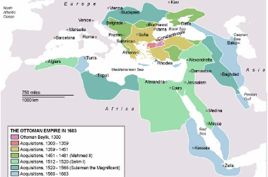
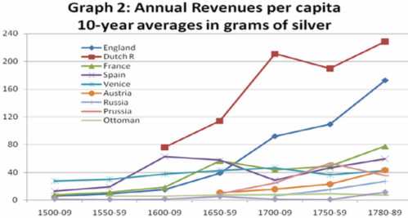
Ottoman Empire
Mehmet II “the Conqueror”’s army takes Constantinople in 1453
Most successful gunpowder empire of its day:
Biggest and most effective artillery park in the world
Best-disciplined infantry soldiers in the world: the janissaries
Highly-motivated professional, feudal, and conquistador cavalry: timarli sipahilar, kapikulu sipahilar, & akincilar
But in the Outer Empire state both predatory & weak:
Around 1800 in Egypt the Mamluks were extracting 2/3 of peasant incomes through taxes (Owen, p. 36).
In Anatolia about 50% (p. 37).
Owen: “not a situation which permitted any accumulation of capital in the agricultural sector nor any regular increase in production…”
2:15
Notes:
In 1453 the armies of Sultan Mehmet II Osmanli, called “the conqueror” showed up outside the walls of Constantinople. Constantinople then was no longer the city of half a million it hahadve been in the 400s. Perhaps 50,000 people lived with in its walls, and much of it had become farming villages. Still, it was the seat of the Eastern Roman Empire, and Emperor Constantine was the heir to a regime that could claim to be continuous with the first Emperor Augustus Caesar’s assumption of power as Princeps after his admirals had defeated Marcus Antonius at the Battle of Actium.
Constantinople had fallen to internal coups, and once to a surprise double-cross by Frankish crusaders let inside the walls as allies. But it had never been conquered by seige. But Mehmet II was at the head of the most successful gunpowder empire of its day. He had the biggest and most effective artillery park that the world had hitherto seen. He had the best-disciplined corps of infantry soldiers then existing in the world: the janissaries. He had highly-motivated professional, feudal, and conquistador cavalry—the timarli sipahilar, kapikulu sipahilar, & akincilar. The days when crusaders from the west could take the pressure off of Constantinople by fighting in Palestine or Egypt were long gone. The last two crusades had been disasters: the Ottomans had decisively defeated the Crusade of Nicopolis in 1396 and the Crusade of Varna in 1444. And so Constantinople fell, and became the Sultan’s capital. Thereafter the Ottoman Sultans possessed the title Kaysar-i-Rum: Caesar of Rome, which they held until the deposition of the last Ottoman sultan in 1922.
But the empire was a military-bureaucratic superstructure on top of a peasant-mercantile economy. In the outer empire the state was both predatory & weak, extracting between 1/2 and 2/3 of peasant incomes through taxes almost all of which were then siphoned off by local notables and bureaucrats, with very little reaching the center. It was “not a situation which permitted any accumulation of capital in the agricultural sector nor any regular increase in production.”

Slide 5
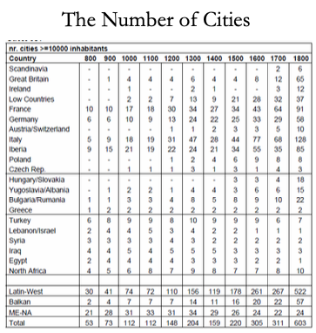
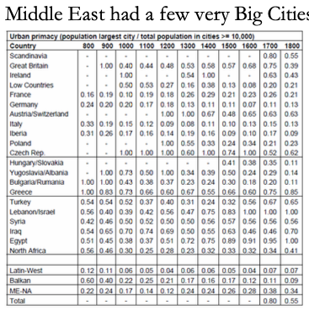
Urbanization
The Ottoman Empire had a few very large cities:
Parasitic rent extraction-funded cities…
2:15
Notes:
In the inner empire the state was predatory but strong—strong enough to keep a hereditary nobility and notable class from becoming organized and powerful enough to constrain the sultan. Feifs and monopolies never became hereditary—thus property never became hereditary and secure—but was always in the gift of the sultan, who could give and take away at whim.
In the year 1400 the urban population of the Middle East was perhaps equal to the urban population of Europe. But the Middle East cities were few and very large: centers of elite consumption not of trade, rather than parts of a distributed productive network providing services and commodities to and paying for imports from the countryside. Instead, overwhelmingly the cities in the Ottoan Empire taxed the countryside and then did nothing to develop or support it. To become too rich and too successful as an urban merchant was to become a target without powerful political protectors of your own. And then one might as well enter the game of becoming a political protector, rather than continuing to expand mercantile or manufacturing activity.
By the year 1500, Europe recovering still from the Black Death sees perhaps half again as many cities as 1400. The Middle East sees fewer cities. And by 1800 the urban population of Europe is easily five times that of the Middle East.
The Ottoman Empire ought to have benefited from the Columbian exchange as much as other parts of the world. The Ottoman Empire, located next to the expanding commercial societies of Europe, ought to have been able to take advantage to share more fully in the benefits of the commercial revolution. Was it all the redirection of global trade from through the Middle East to around the Cape of Good Hope—the closing-off of the Silk Road and related routes—that caused the extremely rapid relative decline of commercial activity in the Middle East? This is a puzzle, or at least something to note, because India and China appear to share fully in the commercial revolution era expansion of trade.

Slide 6
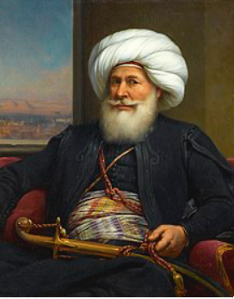
Egypt
Muhammad Ali Pasha al-Mas'ud ibn Agha:
Reigned 1805-1848
Albanian orphan, tax collector in the Ottoman-ruled Greek port of Kavala, bored
Signed up as a mercenary in the Ottoman army sent to reoccupy Egypt
By 1803 commanded a regiment of his fellow Albanians
Ottoman governor of Egypt could not afford to pay his soldiers… Mutiny! Muhammed Ali wound up on top…
1:15
Notes:
Muhammed Ali (1769-1849), an Albanian orphan, son of a shipping merchant Ibrahim Agha and his wife Zeynep, was bored being a tax collector in the Ottoman-ruled Greek port of Kavala. In 1801 he enlisted as a mercenary in the Ottoman army sent to occupy Egypt. By 1803 he commanded a regiment of his ethnically Albanian fellow-countrymen.
The Ottoman governor of Egypt could not afford to pay. He dismissed his Albanian troops. They mutinied, took over the government, and collected their pay. But Albanian commander Tahir Pasha then had no money to pay the Turkish janissaries.
Somehow Muhammed Ali wound up on top.
He retained the loyalty of his Albanians and managing to suppress both Turkish janissaries and Egyptain Mamluks. He then received at least the temporary blessing of Ottoman Sultan Selim III the Reformer (before he was deposed, imprisoned, and murdered by his own janissaries).

Slide 7
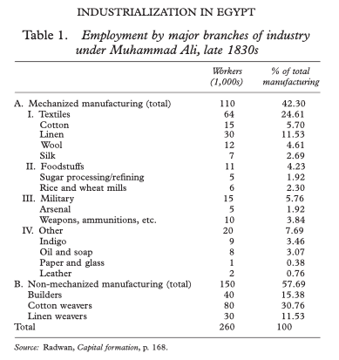
Egypt’s Position as of 1805
Napoleon had showed up and conquered the place, then left:
Egypt at the crossroads
Egypt a good kingdom to rule
The Europeans were likely to come again
Make Egypt Great Again:
New crops
Land reform
A modern military
A focus on cotton as an export
Construction of state-owned textile factories to jump-start Egyptian industrialization
Cannon & musket factories
A shipyard
Dams & railroads
Copy the French engineering Ecole Polytechnique
Medical school for women
Why? Because otherwise his great-grandchildren would become the playthings of French bankers and British proconsuls…
1:00
Notes:
Muhammed Ali, son of Agha, called “the fortunate”, looked northwest at Europe and east to India. He noted Egypt’s role as crossroads between Africa and Asia, and between the Atlantic-Mediterranean Sea and the Red Sea-Indian Ocean. He ruled a prosperous kingdom—but he saw that Europeans might do to his or his children’s kingdom what Europeans had done to prosperous kingdoms in India.
So Muhammed Ali strove to make Egypt great: new crops, land reform, a modern military, a focus on cotton as an export, and the construction of state-owned textile factories to jump-start Egyptian industry. He understood that unless he could keep the machines working, his great-grandchildren would become the puppets of French bankers and British proconsuls.

Slide 8
Muhammed Ali’s Strategy
Make Egypt great again:
Why?
Because otherwise his great-grandchildren would become the playthings of French bankers and British proconsuls…
Population of Egypt in 1840: 5 million?
Figure 1.2 million in the potential outside-the-home paid or self-employed labor force.
By the late 1830s one in five was at work in manufacturing
By the late 1830s one in 11 was at work in mechanized manufacturing
In an era in which British manufactured exports were deindustrializing every other peripheral country on the globe, impressive…
1:15
Notes:
Population of Egypt in 1840 was perhaps 5 million, so figure that 1.2 million was the size of the potential outside-the-home paid or self-employed labor force.
Of these people, by the late 1830s one in five was at work in manufacturing. By the late 1830s one in eleven was at work in mechanized manufacturing: 65,000 in textiles, 11,000 processing sugarcane and milling wheat and rice, 15,000 making weapons, plus more.
In an era in which British manufactured exports were deindustrializing every other peripheral country on the globe, impressive.
The products of the factories were sold to Egyptians—not exported. Egypt did not have the power to prohibit manufactured imports: it was still, as far as its external tariffs were concerned, a part of the Constantinople-centered Ottoman Empire, and the Ottoman sultan needed the forbearance of the British Empire, which he bought by being as agreeable as possible to Britain. Tariffs were low. But British goods landed on the docks of Alexandria could simply not be processed through the customs bureau. And within Egypt non-tariff barriers could prevent the movement and sale of goods.

Slide 9
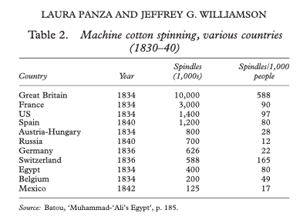
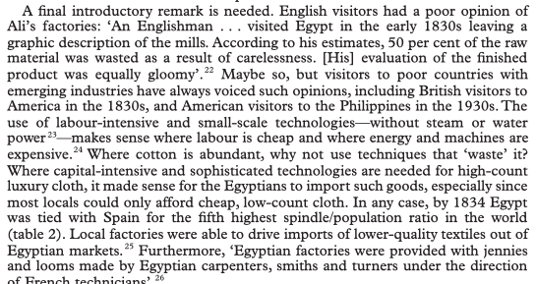
Was the Stuff Produced Useful?
Make Egypt ninth in the world in cotton spinning in the 1830s:
As many spindles per capita as the United States or France or Spain
And many more than Belgium, Germany, Austria-Hungary, Russia, or Mexico
Admittedly it had a captive market in Egypt:
The military had to buy from Muhammed Ali’s factories
As did other internal Egyptian customers cut off from products that did not carry the domestic-manufacture internal-transport stamp
0:45
Notes:
Mohammed Ali’s industrial policies made Egypt ninth in the world in cotton spinning in the 1830s. It had as many spindles per capita as the United States or France or Spain. It had many more spindles per capita than Belgium, Germany, Austria-Hungary, Russia or Mexico.
Admittedly, the products of its factories had a captive market in Egypt: the military had to buy from Muhamed Ali’s factories, as did other internal Egyptian customers cut off from product they did not carry the domestic manufacture internal transport stamp.

Slide 10
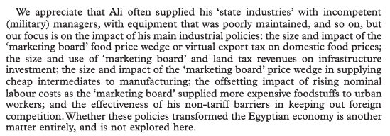
Were the Factories Profitable?
NO!:
After 1840 the system is dismantled
Muhammed Ali is old and sick, his favorite son Ibrahim has tuberculosis, the next heir his grandson Abbas was called “bigoted and sensual”
The factories were expensive
No self-sustaining communities of engineering practice or of industrial entrepreneurship emerged
Abbas shut it all down
2:00
Notes:
Were the factories profitable? NO! Were subsidies and the policies continued? They were soft-pedaled in the 1840s, at the end of Muhammed Ali’s reign, and then dismantled under his successor. Muhammed Ali was old and sick, his favorite son Ibrahim had tuberculosis and died before him, the next heir his grandson Abbas was called “bigoted and sensual”. The factories were expensive. Change was a source of trouble. Money could be spent on racehorses and palaces and provide more pleasure to the ruler.
No self-sustaining communities of engineering practice or of industrial entrepreneurship emerged
And so Abbas shut it all down.
Laura Panza and Jeffey Williamson write somewhat defensively:
>We appreciate that Ali often supplied his "state industries" with incompetent (military) managers, with equipment that was poorly maintained, and so on, but our focus is on the impact of his main industrial policies: the size and impact of the "marketing board" food price wedge or virtual export tax on domestic food prices; the size and use of "marketing board" and land tax revenues on infrastructure investment; the size and impact of the "marketing board" price wedge in supplying cheap intermediates to manufacturing; offsetting impacts of rising nominal labor cost as the "marketing board" supplied more expensive foodstuffs to urban workers; and the effectiveness of his nontariff barriers in keeping out foreign competition. Whether these policies transformed the Egyptian economy is another matter entirely, and is not explored here.
They did not transform the Egyptian economy.
They were not self-sustaining after the subsidies were removed. No domestic entrepreneurs wanted to fill in the gap left by the exit of the state from mechanized textile production.

Slide 11
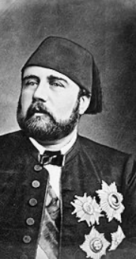
The Khedive Ismail
The Egyptian succession:
Muhammed Ali (1805-48), grandson Abbas (1848-54), uncle Said (1854-63), nephew Ismail (1863-79)
The machines could not be kept working
The cotton boom of the 1860s
Suez Canal opened 1869
1876 state bankruptcy
Egyptian independence ended with Ismail, with puppets only afterwards
2:15
Notes:
In Egypt in the first half of the 1800s, the machines could not be kept working.
Muhammed Ali (1805-48), grandson Abbas (1848-54), uncle Said (1854-63), nephew Ismail (1863-79)
In 1863, six years before the completion of the Suez Canal, the relatively young Khedive Ismail took the throne of Egypt.
Ismail had been educated in France: he was open to European influences, eager to modernize his country, and eager to play the role of the open-handed Eastern ruler. He became ruler of Egypt in 1863, in the middle of the "cotton famine" created by the American Civil War and the consequent temporary disappearance of the U.S. South from the world's cotton supply. The consequence was a cotton boom everywhere else in the world: the factories of the industrial revolution needed cotton to run on, and they were willing to pay almost any price for it. Egypt grew cotton. And so for a few years it seemed as though Egypt's economic resources and wealth were growing rapidly and were inexhaustible.
Suez Canal opened in 1869. That made Egypt truly strategic in the geopolitics of the 1800s.
But the cotton boom was followed by a bust. In 1876 the Egyptian government declared bankruptcy. The creditors of the Khedive became the rulers of the country. Ismail abdicated. Two financial controllers—one British, one French—were appointed with substantial control over taxes and expenditures. Their task was to make sure that Egypt was “governed” by Ismail's son to keep up revenue and pay off the debt. The Egyptians wondered why they were being highly-taxed to pay off debts run up by their extravagant ex-Khedive. British troops restored order in 1882. Thereafter the Khedive was a British puppet: the strategic importance of the Suez Canal for communications with India meant that British troops were to stay in Egypt on varying pretexts and for various reasons until 1956.
Muhammed Ali’s great-grandchildren were indeed the puppets of French bankers and British proconsuls

Slide 12
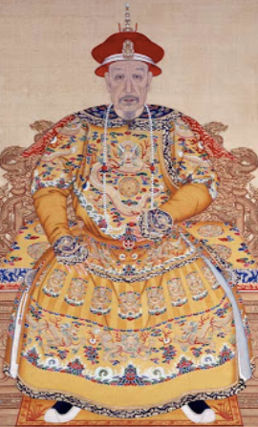
Qing Dynasty China
“Revere the emperor & resist the barbarians!” will not work:
Many western China specialists see and can almost touch an alternative history
One in which late-nineteenth century China stood up economically, politically, and organizationally.
Japan, after all:
won its short victorious war against Russia in 1905,
negotiated as an equal with Britain and the U.S. over warship construction in 1921,
was perhaps the eighth industrial power in the world by 1929
We economists tend to be more skeptical:
QIMCS built up under Robert Hart in the 1860s
Failure of infrastructure management
Failure to collect the salt tax
Failure to suppress the Taiping
Lack of realism—fighting France over Vietnam
2:30
Notes:
imperial China, poor and disorganized in 1870: a country where the government and the economy were in crisis. The ethnically Manchurian Qing Dynasty could not rally the country behind a slogan like “revere the emperor and resist the foreign barbarians” because the emperor and his relatives identified themselves as foreigners. Moreover, they were regarded by the Han elite as barbarians.
Over more than two centuries of rule the Qing government of China had trained its Confucian landlord-bureaucrat-scholar aristocracy to be incapable of taking effective action. Effective action might be directed against the Central Government Security Perimeter (which is, perhaps, how we ought to translate what was back then translated as “Forbidden City”).
Many western China specialists see and can almost touch an alternative history—one in which late-nineteenth century China stood up economically, politically, and organizationally. Japan, after all, won its short victorious war against Russia in 1905, negotiated as an equal with Britain and the U.S. over warship construction in 1921, and was perhaps the eighth industrial power in the world by 1929.
We economists are much more skeptical. We note that while things like the Qing Imperial Maritime Customs Service built up in the 1860s under Robert Hart, Hart allowed no Chinese officials in it primarily because he feared he would be unable to control their corruption, given the powerful protectors in the Qing imperial court such officials would acquire. We note the corrupt and incompetent bureaucracies that failed to manage the Yellow River dikes and the Grand Canal. We note that the Qing could not get their local officials to collect the salt tax. We note that when in the mid-1880s the Qing Dynasty, having bought foreign metal-working machinery and built a navy, arsenals, and docks, thought it was strong enough to oppose the French conquest of Vietnam. Its fleet was destroyed in an hour: the Chinese navy lost 572 dead, while the French lost five. In 1895 the Qing Dynasty thought it was strong enough to oppose the Japanese extension of their sphere of influence to Korea. It was wrong. The Treaty of Shimonoseki added Taiwan, Korea, and southern Manchuria to Japan's sphere of influence.

Slide 13
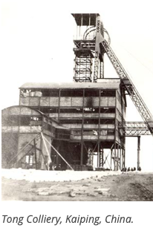
The Kaiping Coal Mine
Li Hongzhang and Tang Tingshu decide to try to jump-start industrialization:
Chi Shihchang, a vice-president of the Board of Civil Offices: “Mining methods angered the earth dragon... [and so] the late empress could not rest quietly in her grave…”
Chang Yenmao:
A political fixer for Cixi
Perhaps the wealthiest man in Tientsin
Herbert Hoover and the Boxer Rebellion
What had been a strategic property to jumpstart Chinese industrialization became something else…
Li Hongzhang and Sun Yatsen
6:45
Notes:
Consider the story of the Kaiping coal mine. Li Hongzhang was the bureaucratic prime mover behind that and such other “self-strengthening efforts” as the 1878 cotton mills in Shanghai, the Tianjin arsenal, the telegraph between Tianjin and Peking, and more. Individual governors-general like Li Hongzhang who made economic development a top priority could make some things happen—elsewhere things did not happen, outside of the foreign concessions and treaty ports like Qingdao, Tientsin, Shanghai, Guangdong, and Hong Kong.
In 1877 he commissioned experienced, wealthy, Hong Kong treaty-port comprador-merchant Tang Tingshu to build a modern, industrial, large-scale coal mine in Kaiping. They faced unusual forms of opposition. A British telegraph cable of 1882 stating that mining work had been stopped because Chi Shihchang, a vice-president of the Board of Civil Offices, had declared that: “mining methods angered the earth dragon... [and so] the late empress could not rest quietly in her grave…” Li Hongzhang was this given the choice between abandoning his project for a modern coal mine to fuel steam engines or accepting blame for any death or disease that might strike the imperial family. Given the size of the imperial family and mortality in the late nineteenth century, it would be a brave bureaucrat indeed who certify that there was no geomantic danger to the grave of the late empress from the earth dragon.
Li Hongzhang was brave.
Production began in 1881. By 1889, 3000 workers in three shifts were producing 700 tons of coal a day using steam lifts, underground coal cars on rails, and pneumatic drills. By 1900, 9000 workers were producing 200 tons OF coal a day The miners were producing 1/4 of what was expected of miners in America or Australia.
The mine was both a public governmental project and a private capitalist enterprise. The mine director was both an employee of the company’s Hong Kong shareholders and an official of the Qing administrative bureaucracy. Thus when mine director-general Tang Tingshu died in 1892 his replacement, Chang Yenmao, was neither a merchant nor an industrialist nor an engineer. Chang Yenmao was a political fixer for the Empress Dowager Cixi.
By 1900 Chang Yenmao was perhaps the wealthiest men in Tientsin.
Herbert Hoover at the time was a 26 year-old expatriate mining engineer on the make. Herbert Hoover arrived in Tientsin in 1900 just in time to be besieged in the city by the Boxer—a better translation would be the “Fighters United for Justice”—Rebellion. Mine director-general Chang Yenmao had fled to inside Tientsin. He feared, rightly, that the Boxers would execute him as a corrupt puppet of the European. Inside Tientsin he found that the besieged Europeans wanted to execute him for passing intelligence to the Boxers.
Somehow Hoover got Chang released from prison. Somehow Chang gave Hoover a power of attorney to reincorporate the Kaiping mine as a British-flag enterprise in London controlled completely by Herbert Hoover as the representative on the spot of the London-based majority shareholders. The new company also had a Europeans-only club. The local British charge d'affaires on the spot was disgusted at how Hoover and company had: “made a pretty pile at the expense of the Chinese.... legally the Board of Directors were unassailable... but... morally they were in the wrong.... [Britain should not] give its countenance to a financial transaction which had fleeced Chinese shareholders... lined the pockets of an Anglo-Belgian gang…” And Chang Yenmao and his associates were “wild… [because] they thought themselves rather smarter... and got themselves fairly had by a Yankee man of straw…” named Herbert Hoover.
In 1901 Herbert Hoover took over the mine.
He found that the 9000-worker payroll had been padded by 6000 names, and that the director of personnel doing the padding and collecting the wages had paid Chang Yenmao £10000—50,000—for the post. Under Chang Yenmao’ the company paid £20000—100000 dollars—a year in dividends. Hoover was able to pay out £150,000—750,000 dollars—a year in dividends.
The upshot was that what Li Hongzhang and his successor in the Qing government Yuan Shihkai had thought was a strategic imperial government enterprise was now the property of a British-Belgian investors’ syndicate, with no interest in building China’s engineering capacity or supporting its foreign policy strategy.
A social-economic structure that could not find and promote executives but instead replaced them with corrupt political fixers, a political-ritual culture that required that a modernizing governor focus his attention constantly on the enterprise and run interference to protect it from anti-modernizers, and an educational system that continued to turn out literati instead of engineers and thus required foreign technical personnel for everything—outside the charmed circles created by the extraterritorial foreign concessions, and to a slight degree the immediate span of control of the few modernizing governors, modern industries did not develop and modern technologies were simply not applied in late imperial China.
Visionary reforming politician Sun Yatsen had offered his services to Li Hongzhang in 1894, but Li sent him away. Sun Yatsen built up a financial and propaganda network among Chinese emigrants beyond the reach of the government. Military politicians like Yuan Shihkai came to the conclusion that working with the Manchu court was useless. At the beginning of 1912 Sun Yatsen launched his rebellion, and the Qing dynasty fell. Yuan Shihkai and his peers refused to suppress the rebellion, and thought their chances would be better without the Manchu Dynasty.
The six-year-old emperor abdicated. The new Chinese republic’s president turned out to be not Sun Yatsen military politician Yuan Shihkai. But Yuan Shihkai’s authority over his peers and near peers—army commanders, provincial governors, and other would-be warlords—was nil.
China descended into near-anarchy.

Slide 14
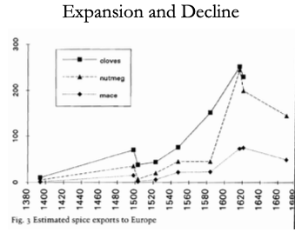
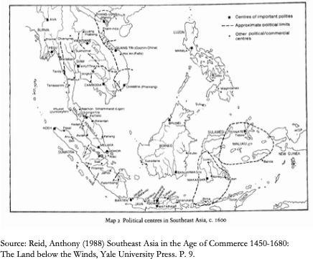
Dutch Colonial Indonesia
In the 16th century, Java (in modern Indonesia) and Malaysia were amongst the most urbanized places in the world:
Then the Dutch show up, with ships and cannon and muskets and well-drilled infantry…
And by 1900 Indonesia is very poor…
Ambon and Banda:
In Ambon the V.O.C. took over the existing feudal structure, which they used to monopolize supply.
In Banda, the V.O.C.:
killed most of the population in 1621 (probably over 20,000 people)
reorganized the production of nutmeg
established slavery system
ex-employees of the VOC as planters
“Comprador” elites…
De-economization: Reid (1993, Chapter 5): “When a Dutch factor visited Magindanao in 1686 he was told “Nutmeg and cloves can be grown here, just as in Malaku. They are not there now because the old Raja had all of them ruined before his death. He was afraid the Dutch Company would come to fight with them about it…”
2:00
Notes:
In 1453 the armies of Sultan Mehmet II Osmanli, called “the conqueror” showed up outside the walls of Constantinople. Constantinople then was no longer the city of half a million it hahadve been in the 400s. Perhaps 50,000 people lived with in its walls, and much of it had become farming villages. Still, it was the seat of the Eastern Roman Empire, and Emperor Constantine was the heir to a regime that could claim to be continuous with the first Emperor Augustus Caesar’s assumption of power as Princeps after his admirals had defeated Marcus Antonius at the Battle of Actium.
Constantinople had fallen to internal coups, and once to a surprise double-cross by Frankish crusaders let inside the walls as allies. But it had never been conquered by seige. But Mehmet II was at the head of the most successful gunpowder empire of its day. He had the biggest and most effective artillery park that the world had hitherto seen. He had the best-disciplined corps of infantry soldiers then existing in the world: the janissaries. He had highly-motivated professional, feudal, and conquistador cavalry—the timarli sipahilar, kapikulu sipahilar, & akincilar. The days when crusaders from the west could take the pressure off of Constantinople by fighting in Palestine or Egypt were long gone. The last two crusades had been disasters: the Ottomans had decisively defeated the Crusade of Nicopolis in 1396 and the Crusade of Varna in 1444. And so Constantinople fell, and became the Sultan’s capital. Thereafter the Ottoman Sultans possessed the title Kaysar-i-Rum: Caesar of Rome, which they held until the deposition of the last Ottoman sultan in 1922.
But the empire was a military-bureaucratic superstructure on top of a peasant-mercantile economy. In the outer empire the state was both predatory & weak, extracting between 1/2 and 2/3 of peasant incomes through taxes almost all of which were then siphoned off by local notables and bureaucrats, with very little reaching the center. It was “not a situation which permitted any accumulation of capital in the agricultural sector nor any regular increase in production.”
——
In the inner empire the state was predatory but strong—strong enough to keep a hereditary nobility and notable class from becoming organized and powerful enough to constrain the sultan. Feifs and monopolies never became hereditary—thus property never became hereditary and secure—but was always in the gift of the sultan, who could give and take away at whim.
In the year 1400 the urban population of the Middle East was perhaps equal to the urban population of Europe. But the Middle East cities were few and very large: centers of elite consumption not of trade, rather than parts of a distributed productive network providing services and commodities to and paying for imports from the countryside. Instead, overwhelmingly the cities in the Ottoan Empire taxed the countryside and then did nothing to develop or support it. To become too rich and too successful as an urban merchant was to become a target without powerful political protectors of your own. And then one might as well enter the game of becoming a political protector, rather than continuing to expand mercantile or manufacturing activity.
By the year 1500, Europe recovering still from the Black Death sees perhaps half again as many cities as 1400. The Middle East sees fewer cities. And by 1800 the urban population of Europe is easily five times that of the Middle East.
The Ottoman Empire ought to have benefited from the Columbian exchange as much as other parts of the world. The Ottoman Empire, located next to the expanding commercial societies of Europe, ought to have been able to take advantage to share more fully in the benefits of the commercial revolution. Was it all the redirection of global trade from through the Middle East to around the Cape of Good Hope—the closing-off of the Silk Road and related routes—that caused the extremely rapid relative decline of commercial activity in the Middle East? This is a puzzle, or at least something to note, because India and China appear to share fully in the commercial revolution era expansion of trade.
—-
Muhammed Ali (1769-1849), an Albanian orphan, son of a shipping merchant Ibrahim Agha and his wife Zeynep, was bored being a tax collector in the Ottoman-ruled Greek port of Kavala. In 1801 he enlisted as a mercenary in the Ottoman army sent to occupy Egypt. By 1803 he commanded a regiment of his ethnically Albanian fellow-countrymen.
The Ottoman governor of Egypt could not afford to pay. He dismissed his Albanian troops. They mutinied, took over the government, and collected their pay. But Albanian commander Tahir Pasha then had no money to pay the Turkish janissaries.
Somehow Muhammed Ali wound up on top.
He retained the loyalty of his Albanians and managing to suppress both Turkish janissaries and Egyptain Mamluks. He then received at least the temporary blessing of Ottoman Sultan Selim III the Reformer (before he was deposed, imprisoned, and murdered by his own janissaries).
——
Muhammed Ali, son of Agha, called “the fortunate”, looked northwest at Europe and east to India. He noted Egypt’s role as crossroads between Africa and Asia, and between the Atlantic-Mediterranean Sea and the Red Sea-Indian Ocean. He ruled a prosperous kingdom—but he saw that Europeans might do to his or his children’s kingdom what Europeans had done to prosperous kingdoms in India.
So Muhammed Ali strove to make Egypt great: new crops, land reform, a modern military, a focus on cotton as an export, and the construction of state-owned textile factories to jump-start Egyptian industry. He understood that unless he could keep the machines working, his great-grandchildren would become the puppets of French bankers and British proconsuls.
——
Population of Egypt in 1840 was perhaps 5 million, so figure that 1.2 million was the size of the potential outside-the-home paid or self-employed labor force.
Of these people, by the late 1830s one in five was at work in manufacturing. By the late 1830s one in eleven was at work in mechanized manufacturing: 65,000 in textiles, 11,000 processing sugarcane and milling wheat and rice, 15,000 making weapons, plus more.
In an era in which British manufactured exports were deindustrializing every other peripheral country on the globe, impressive.
The products of the factories were sold to Egyptians—not exported. Egypt did not have the power to prohibit manufactured imports: it was still, as far as its external tariffs were concerned, a part of the Constantinople-centered Ottoman Empire, and the Ottoman sultan needed the forbearance of the British Empire, which he bought by being as agreeable as possible to Britain. Tariffs were low. But British goods landed on the docks of Alexandria could simply not be processed through the customs bureau. And within Egypt non-tariff barriers could prevent the movement and sale of goods.
——
Mohammed Ali’s industrial policies made Egypt ninth in the world in cotton spinning in the 1830s. It had as many spindles per capita as the United States or France or Spain. It had many more spindles per capita than Belgium, Germany, Austria-Hungary, Russia or Mexico.
Admittedly, the products of its factories had a captive market in Egypt: the military had to buy from Muhamed Ali’s factories, as did other internal Egyptian customers cut off from product they did not carry the domestic manufacture internal transport stamp.
——
Were the factories profitable? NO! Were subsidies and the policies continued? They were soft-pedaled in the 1840s, at the end of Muhammed Ali’s reign, and then dismantled under his successor. Muhammed Ali was old and sick, his favorite son Ibrahim had tuberculosis and died before him, the next heir his grandson Abbas was called “bigoted and sensual”. The factories were expensive. Change was a source of trouble. Money could be spent on racehorses and palaces and provide more pleasure to the ruler.
No self-sustaining communities of engineering practice or of industrial entrepreneurship emerged
And so Abbas shut it all down.
Laura Panza and Jeffey Williamson write somewhat defensively:
>We appreciate that Ali often supplied his "state industries" with incompetent (military) managers, with equipment that was poorly maintained, and so on, but our focus is on the impact of his main industrial policies: the size and impact of the "marketing board" food price wedge or virtual export tax on domestic food prices; the size and use of "marketing board" and land tax revenues on infrastructure investment; the size and impact of the "marketing board" price wedge in supplying cheap intermediates to manufacturing; offsetting impacts of rising nominal labor cost as the "marketing board" supplied more expensive foodstuffs to urban workers; and the effectiveness of his nontariff barriers in keeping out foreign competition. Whether these policies transformed the Egyptian economy is another matter entirely, and is not explored here.
They did not transform the Egyptian economy.
They were not self-sustaining after the subsidies were removed. No domestic entrepreneurs wanted to fill in the gap left by the exit of the state from mechanized textile production.
——
In Egypt in the first half of the 1800s, the machines could not be kept working.
Muhammed Ali (1805-48), grandson Abbas (1848-54), uncle Said (1854-63), nephew Ismail (1863-79)
In 1863, six years before the completion of the Suez Canal, the relatively young Khedive Ismail took the throne of Egypt.
Ismail had been educated in France: he was open to European influences, eager to modernize his country, and eager to play the role of the open-handed Eastern ruler. He became ruler of Egypt in 1863, in the middle of the "cotton famine" created by the American Civil War and the consequent temporary disappearance of the U.S. South from the world's cotton supply. The consequence was a cotton boom everywhere else in the world: the factories of the industrial revolution needed cotton to run on, and they were willing to pay almost any price for it. Egypt grew cotton. And so for a few years it seemed as though Egypt's economic resources and wealth were growing rapidly and were inexhaustible.
Suez Canal opened in 1869. That made Egypt truly strategic in the geopolitics of the 1800s.
But the cotton boom was followed by a bust. In 1876 the Egyptian government declared bankruptcy. The creditors of the Khedive became the rulers of the country. Ismail abdicated. Two financial controllers—one British, one French—were appointed with substantial control over taxes and expenditures. Their task was to make sure that Egypt was “governed” by Ismail's son to keep up revenue and pay off the debt. The Egyptians wondered why they were being highly-taxed to pay off debts run up by their extravagant ex-Khedive. British troops restored order in 1882. Thereafter the Khedive was a British puppet: the strategic importance of the Suez Canal for communications with India meant that British troops were to stay in Egypt on varying pretexts and for various reasons until 1956.
Muhammed Ali’s great-grandchildren were indeed the puppets of French bankers and British proconsuls
——
imperial China, poor and disorganized in 1870: a country where the government and the economy were in crisis. The ethnically Manchurian Qing Dynasty could not rally the country behind a slogan like “revere the emperor and resist the foreign barbarians” because the emperor and his relatives identified themselves as foreigners. Moreover, they were regarded by the Han elite as barbarians.
Over more than two centuries of rule the Qing government of China had trained its Confucian landlord-bureaucrat-scholar aristocracy to be incapable of taking effective action. Effective action might be directed against the Central Government Security Perimeter (which is, perhaps, how we ought to translate what was back then translated as “Forbidden City”).
Many western China specialists see and can almost touch an alternative history—one in which late-nineteenth century China stood up economically, politically, and organizationally. Japan, after all, won its short victorious war against Russia in 1905, negotiated as an equal with Britain and the U.S. over warship construction in 1921, and was perhaps the eighth industrial power in the world by 1929.
We economists are much more skeptical. We note that while things like the Qing Imperial Maritime Customs Service built up in the 1860s under Robert Hart, Hart allowed no Chinese officials in it primarily because he feared he would be unable to control their corruption, given the powerful protectors in the Qing imperial court such officials would acquire. We note the corrupt and incompetent bureaucracies that failed to manage the Yellow River dikes and the Grand Canal. We note that the Qing could not get their local officials to collect the salt tax. We note that when in the mid-1880s the Qing Dynasty, having bought foreign metal-working machinery and built a navy, arsenals, and docks, thought it was strong enough to oppose the French conquest of Vietnam. Its fleet was destroyed in an hour: the Chinese navy lost 572 dead, while the French lost five. In 1895 the Qing Dynasty thought it was strong enough to oppose the Japanese extension of their sphere of influence to Korea. It was wrong. The Treaty of Shimonoseki added Taiwan, Korea, and southern Manchuria to Japan's sphere of influence.
——
Consider the story of the Kaiping coal mine. Li Hongzhang was the bureaucratic prime mover behind that and such other “self-strengthening efforts” as the 1878 cotton mills in Shanghai, the Tianjin arsenal, the telegraph between Tianjin and Peking, and more. Individual governors-general like Li Hongzhang who made economic development a top priority could make some things happen—elsewhere things did not happen, outside of the foreign concessions and treaty ports like Qingdao, Tientsin, Shanghai, Guangdong, and Hong Kong.
In 1877 he commissioned experienced, wealthy, Hong Kong treaty-port comprador-merchant Tang Tingshu to build a modern, industrial, large-scale coal mine in Kaiping. They faced unusual forms of opposition. A British telegraph cable of 1882 stating that mining work had been stopped because Chi Shihchang, a vice-president of the Board of Civil Offices, had declared that: “mining methods angered the earth dragon... [and so] the late empress could not rest quietly in her grave…” Li Hongzhang was this given the choice between abandoning his project for a modern coal mine to fuel steam engines or accepting blame for any death or disease that might strike the imperial family. Given the size of the imperial family and mortality in the late nineteenth century, it would be a brave bureaucrat indeed who certify that there was no geomantic danger to the grave of the late empress from the earth dragon.
Li Hongzhang was brave.
Production began in 1881. By 1889, 3000 workers in three shifts were producing 700 tons of coal a day using steam lifts, underground coal cars on rails, and pneumatic drills. By 1900, 9000 workers were producing 200 tons OF coal a day The miners were producing 1/4 of what was expected of miners in America or Australia.
The mine was both a public governmental project and a private capitalist enterprise. The mine director was both an employee of the company’s Hong Kong shareholders and an official of the Qing administrative bureaucracy. Thus when mine director-general Tang Tingshu died in 1892 his replacement, Chang Yenmao, was neither a merchant nor an industrialist nor an engineer. Chang Yenmao was a political fixer for the Empress Dowager Cixi.
By 1900 Chang Yenmao was perhaps the wealthiest men in Tientsin.
Herbert Hoover at the time was a 26 year-old expatriate mining engineer on the make. Herbert Hoover arrived in Tientsin in 1900 just in time to be besieged in the city by the Boxer—a better translation would be the “Fighters United for Justice”—Rebellion. Mine director-general Chang Yenmao had fled to inside Tientsin. He feared, rightly, that the Boxers would execute him as a corrupt puppet of the European. Inside Tientsin he found that the besieged Europeans wanted to execute him for passing intelligence to the Boxers.
Somehow Hoover got Chang released from prison. Somehow Chang gave Hoover a power of attorney to reincorporate the Kaiping mine as a British-flag enterprise in London controlled completely by Herbert Hoover as the representative on the spot of the London-based majority shareholders. The new company also had a Europeans-only club. The local British charge d'affaires on the spot was disgusted at how Hoover and company had: “made a pretty pile at the expense of the Chinese.... legally the Board of Directors were unassailable... but... morally they were in the wrong.... [Britain should not] give its countenance to a financial transaction which had fleeced Chinese shareholders... lined the pockets of an Anglo-Belgian gang…” And Chang Yenmao and his associates were “wild… [because] they thought themselves rather smarter... and got themselves fairly had by a Yankee man of straw…” named Herbert Hoover.
In 1901 Herbert Hoover took over the mine.
He found that the 9000-worker payroll had been padded by 6000 names, and that the director of personnel doing the padding and collecting the wages had paid Chang Yenmao £10000—50,000—for the post. Under Chang Yenmao’ the company paid £20000—100000 dollars—a year in dividends. Hoover was able to pay out £150,000—750,000 dollars—a year in dividends.
The upshot was that what Li Hongzhang and his successor in the Qing government Yuan Shihkai had thought was a strategic imperial government enterprise was now the property of a British-Belgian investors’ syndicate, with no interest in building China’s engineering capacity or supporting its foreign policy strategy.
A social-economic structure that could not find and promote executives but instead replaced them with corrupt political fixers, a political-ritual culture that required that a modernizing governor focus his attention constantly on the enterprise and run interference to protect it from anti-modernizers, and an educational system that continued to turn out literati instead of engineers and thus required foreign technical personnel for everything—outside the charmed circles created by the extraterritorial foreign concessions, and to a slight degree the immediate span of control of the few modernizing governors, modern industries did not develop and modern technologies were simply not applied in late imperial China.
Visionary reforming politician Sun Yatsen had offered his services to Li Hongzhang in 1894, but Li sent him away. Sun Yatsen built up a financial and propaganda network among Chinese emigrants beyond the reach of the government. Military politicians like Yuan Shihkai came to the conclusion that working with the Manchu court was useless. At the beginning of 1912 Sun Yatsen launched his rebellion, and the Qing dynasty fell. Yuan Shihkai and his peers refused to suppress the rebellion, and thought their chances would be better without the Manchu Dynasty.
The six-year-old emperor abdicated. The new Chinese republic’s president turned out to be not Sun Yatsen military politician Yuan Shihkai. But Yuan Shihkai’s authority over his peers and near peers—army commanders, provincial governors, and other would-be warlords—was nil.
China descended into near-anarchy.
——
Last, let us look at Dutch colonial Indonesia.
In the 1500s century, Java (in modern Indonesia) and Malaysia were amongst the most urbanized places in the world. Then the Dutch show up, with ships and cannon and muskets and well-drilled infantry. And by 1900 Indonesia is very poor.
Consider Ambon and Banda.
In Ambon the V.O.C. took over the existing feudal structure, which they used to monopolize supply—pay the workers as little as possible, depose feudal princelings who do not do their will, turning them into “compradors”, run the closest they can to maximally extractive institutions.
In Banda, the V.O.C. killed most of the population in 1621 (probably over 20,000 people), reorganized the production of nutmeg, and established lage scale slavery with ex-employees of the VOC as planter-intermediaries.
Melissa Dell quotes Reid (1993, Chapter 5):
>When a Dutch factor visited Magindanao in 1686 he was told “Nutmeg and cloves can be grown here, just as in Malaku. They are not there now because the old Raja had all of them ruined before his death. He was afraid the Dutch Company would come to fight with them about it…”
Up till 1800 or so land-based empires and powers could negotiate with Europeans and divide the surplus from growing world commerce. But anywhere where naval cannon could reach, European colonialists found that they could cheaply and easily impose the most extractive and predatory institutions possible.

Slide 15
Big Ideas: Lecture 21: South Asia & Middle East
Takeaways from this class:
Takeaways from Asia ex-Pacific rim (plus north Africa)?
Ottoman Empire
Egypt
Qing China
Dutch colonialism in Indonesia
Takeaways from our tour of the continents more generally?
North America
Latin America ex-southern cone
Southern cone of South America
East Asian miracles
Africa
Asia ex-Pacific Rim

Slide 16
Readings
Optional readings:
Laura Panza & Jeffrey Williamson (2015): Did Muhammad Ali Foster Industrialization in Early Nineteenth-Century Egypt? <https://github.com/braddelong/public-files/tree/master/readings/notes-panza-%26-williamson-egypt>

Slide 17
Roadmap for the Next Two Weeks…
21. Th Apr 16: 5.4.2. South Asia & Middle East
Read Before: Sevkut Pamuk (2014): Institutional Change and Economic Development in the Middle East, 700-1800 <https://delong.typepad.com/files/pamuk.pdf>
Slides: <https://github.com/braddelong/public-files/blob/master/econ-135-lecture-21.pptx>
6. Policy Issues
22. Tu Apr 21: 6.1. "Deep Roots" vs. Path Dependence
Read Before: Nathan Nunn (2012): Culture and the Historical Process <https://delong.typepad.com/files/nunn-culture.pdf>
Read Before: Melissa Dell (2015): Path Dependence in Development: Evidence from the Mexican Revolution <https://scholar.harvard.edu/files/dell/files/revolutiondraft.pdf>
Slides: <https://github.com/braddelong/public-files/blob/master/econ-135-lecture-22.pptx>
23. Th Apr 23: 6.2. Growth and Fluctuations; Trade and Development, Foreign Aid
Read Before: Barry Eichengreen (2015): Hall of Mirrors: The Great Depression, The Great Recession, and the Uses-and Misuses-of History, selections <https://delong.typepad.com/files/eichengreen-mirrors.pdf>
Read Before: David Atkin (2014): Endogenous Skill Acquisition and Export Manufacturing in Mexico <https://delong.typepad.com/files/atkin-skill.pdf>
Slides: <https://github.com/braddelong/public-files/blob/master/econ-135-lecture-23.pptx>
24. Tu Apr 28: 6.3. Populism, Plutocracy, Kleptocracy, & Neo-Fascism
Read Before: Ernest Gellner (1973): Nations & Nationalism, selections <https://delong.typepad.com/files/gellner-nations.pdf>
Read Before: Barry Eichengreen (2018): The Populist Temptation Economic Grievance & Political Reaction in the Modern Era, selections <https://delong.typepad.com/files/eichengeeen-populist.pdf >
25. Th Apr 30: 6.4. Global Warming
Read Before: Melissa Dell et al. (2012): Temperature Shocks & Economic Growth: Evidence from the Last Half Century <https://scholar.harvard.edu/files/dell/files/aej_temperature.pdf>
Read Before: Melissa Dell et al. (2014). What Do We Learn from the Weather? The New Climate-Economy Literature, selections <https://economics.mit.edu/files/9138>

Slide 18
Roadmap Following…
Tu May 5: 6.5. The Pace and Meaning of Economic Growth
Read Before: William Nordhaus: Do Real-Output and Real-Wage Measures Capture Reality? <https://www.nber.org/chapters/c6064.pdf>
Read Before: John Maynard Keynes: Economic Possibilities for Our Grandchildren<<https://delong.typepad.com/files/keynes-persuasion.pdf>
Read Before: Edward Bellamy (1887): Looking Backward 2000-1887, selections <https://delong.typepad.com/files/bellamy-backward.pdf>
7. Conclusion
Th May 7: 7. Conclusion: The Future?
Read After: Robert Allen (2011): Global Economic History: A Very Short Introduction, selections <https://delong.typepad.com/files/allen-geh.pdf >
W May 13 11:30-14:30: FINAL PAPER/PROJECT DUE

Slide 19
Catch Our Breath…
Ask a couple of questions?
Make a couple of comments?
Any more readings to recommend?

Slide 20
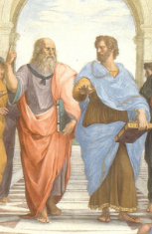
Notes, etc.…

Slide 21
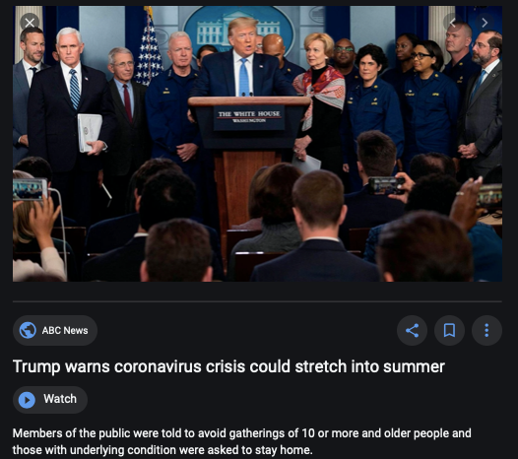
Coronavirus!

Slide 22
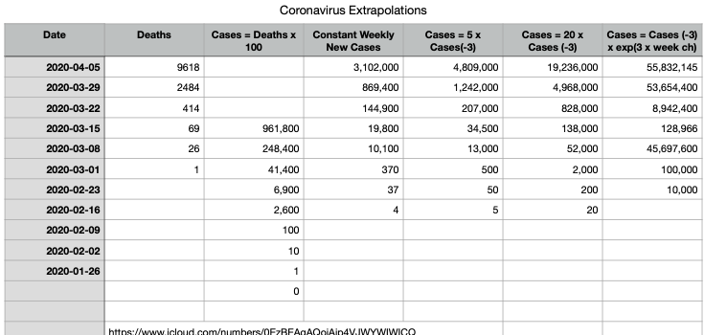
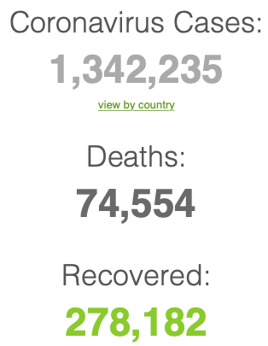
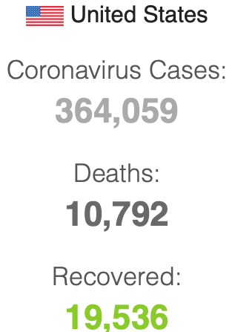
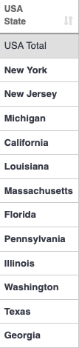
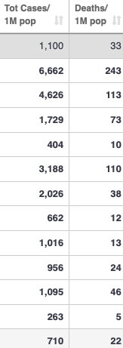
Coronavirus
Where we think we are, as of Th Apr 09:
We really do not know
No random samples…
If we extrapolate out the past week straight-line log:
We will have 440,000 deaths in three weeks
But it is unlikely to be that bad
Best thing I have read comes from Jim Stock <https://drive.google.com/file/d/12MV466ZZy5xHir4xdPhoTrL1oO8CbZU-/view>:
The basic SIR epidemiological model of contagion
The effect of social distancing and business shutdowns on epidemic dynamics enters the model through a single parameter: the case transmission rate β
Re-express the model in terms of β and the asymptomatic (or not very symptomatic) hence non-tested rate—the fraction of the infected who are not tested
The COVID-19 non-testing rate is unidentified in our model
Estimates in the epidemiological literature range from 0.18 to 0.86.
The asymptomatic rate could be estimated accurately and quickly by testing a random sample
The optimal policy response and its economic consequences hinge critically on the asymptomatic rate

Slide 23
Coronavirus II
We do not really know where we are, as of Mo Apr 6:
Best thing I have read comes from Jim Stock <https://drive.google.com/file/d/12MV466ZZy5xHir4xdPhoTrL1oO8CbZU-/view>:
The basic SIR epidemiological model of contagion
The effect of social distancing and business shutdowns on epidemic dynamics enters the model through a single parameter: the case transmission rate β
Re-express the model in terms of β and the asymptomatic (or not very symptomatic) hence non-tested rate—the fraction of the infected who are not tested
The COVID-19 non-testing rate is unidentified in our model
Estimates in the epidemiological literature range from 0.18 to 0.86.
The asymptomatic rate could be estimated accurately and quickly by testing a random sample
The optimal policy response and its economic consequences hinge critically on the asymptomatic rate

Slide 27
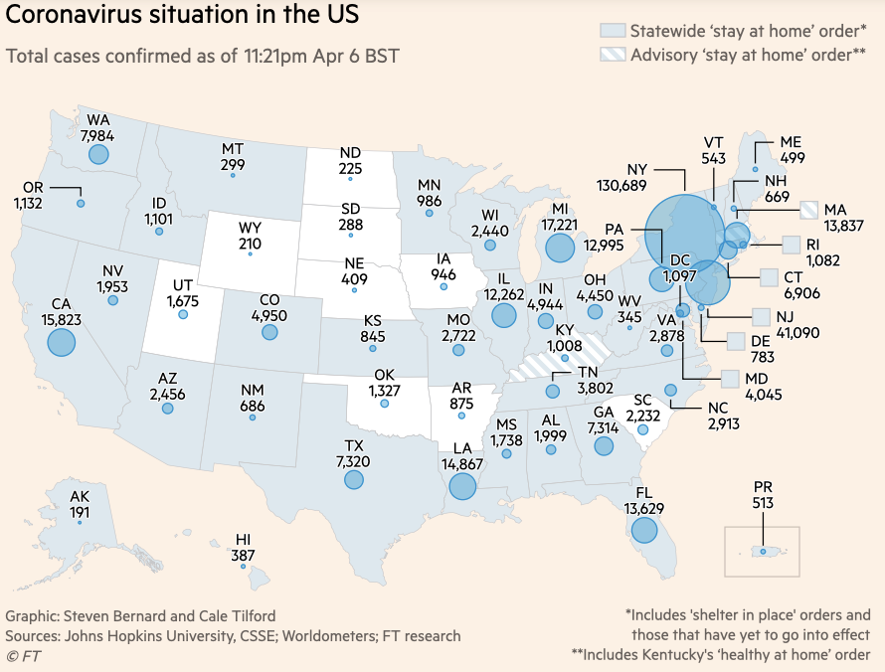
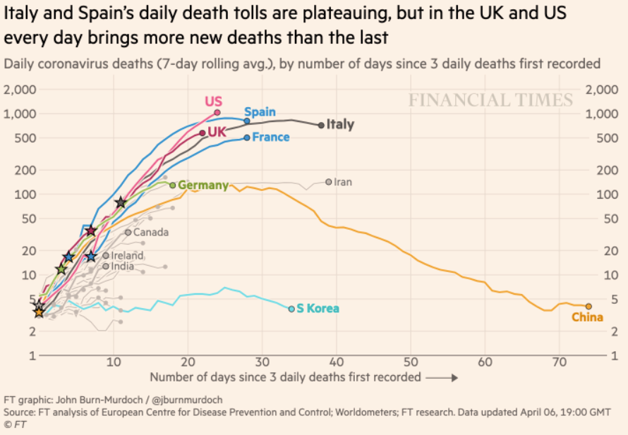
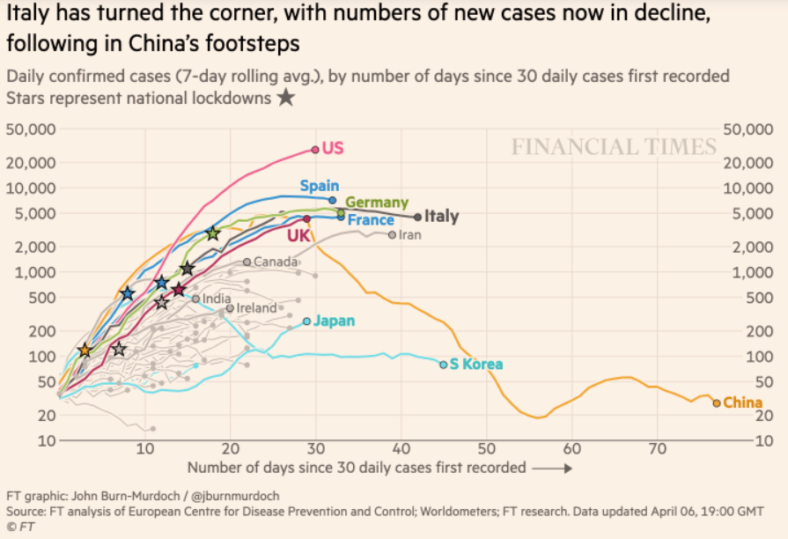
Financial Times Graphs Blown Up…

Slide 31
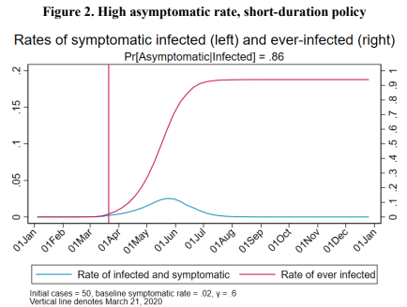
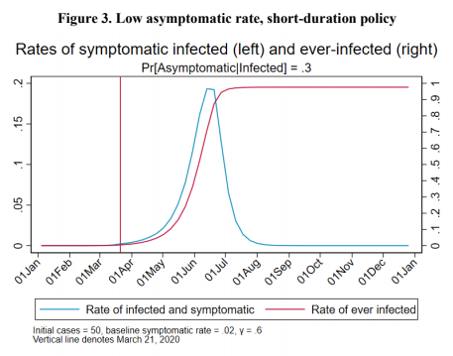
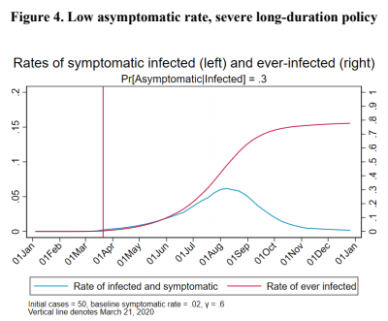
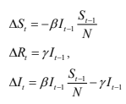
James Stock (2020)
Standard SIR model:<https://drive.google.com/file/d/12MV466ZZy5xHir4xdPhoTrL1oO8CbZU-/view>:
Susceptible, Infected, Recovered (& immune), transmission rate β, recovery rate γ, reproduction number R0, asymptomatic hence non-tested rate π0
Calibration: half-life of infection one week: γ = 0.5, s0 = 0.02, 50 cases on Jan 24
For March 21, 2020, the positive test rate in the United States is approximately 10%…
<https://drive.google.com/file/d/12MV466ZZy5xHir4xdPhoTrL1oO8CbZU-/view>

Slide 36
Bringing the Economy Back Up from Anæsthesia
Major issues:
Certificates of immunity:
Which requires test, test, test:
And not just disease virus tests
Presence-of-antibodies tests
How quickly can we match the immune with public-contact jobs?
What jobs can be done with minimal infection risk?
What minimal-infection substitutes can we find for previous jobs?
How quickly can restrictions be relaxed without the virus coming roaring back?
How do we avoid having the market give a “shutdown” signal to enterprises we in fact want restarted?
Which is pretty much all of them
How much of the potential caseload do we want to push out beyond the vaccine-arrival date?
ALL THESE QUESTIONS ARE ANSWERABLE IF WE LEARN THE ASYMPTOMATIC HENCE NON-TESTED RATE!!

Slide 37
Keeping the Economy from Crashing During the Lockdown
Nick Rowe: We have a 50% output cut in 100% of the sectors:
A temporary 100% output cut in 50% of the sectors (what the Coronavirus does) is very different from a 50% output cut in 100% of the sectors
Nick’s thought experiment:
In three months we are going to invent unobtanium:
Substantial intertemporal substitutibility
Plus lower cross-good contemporaneous substitutitbility
Hence high desired savings rate now
Flex-price market thus produces a nominal rate at the zero lower bound and a high inflation rate over the next three to six months
Plus liquidity-constrained workers in affected sectors see their demand go to zero immediately
Can we get there? Should we get there? What should we do instead?
We need a good RBC economist: are there any?…
<https://worthwhile.typepad.com/worthwhile_canadian_initi/2020/03/relative-supply-shocks-unobtainium-walras-law-and-the-coronavirus.html>

Slide 38
Keeping the Economy from Crashing During the Lockdown II
Nick Rowe:
<https://worthwhile.typepad.com/worthwhile_canadian_initi/2020/03/relative-supply-shocks-unobtainium-walras-law-and-the-coronavirus.html>
Plus: to extend the thought experiment:
We just lost the ability to make “unobtainium”
So we should be substituting leisure for work, and moving workers into relatively unproductive labor, making the commodities we can still produce right now
How should relative prices move as a result? How should we make them move?
Plus: distributional issues
Plus: bankruptcy and credit chain issues

Slide 39
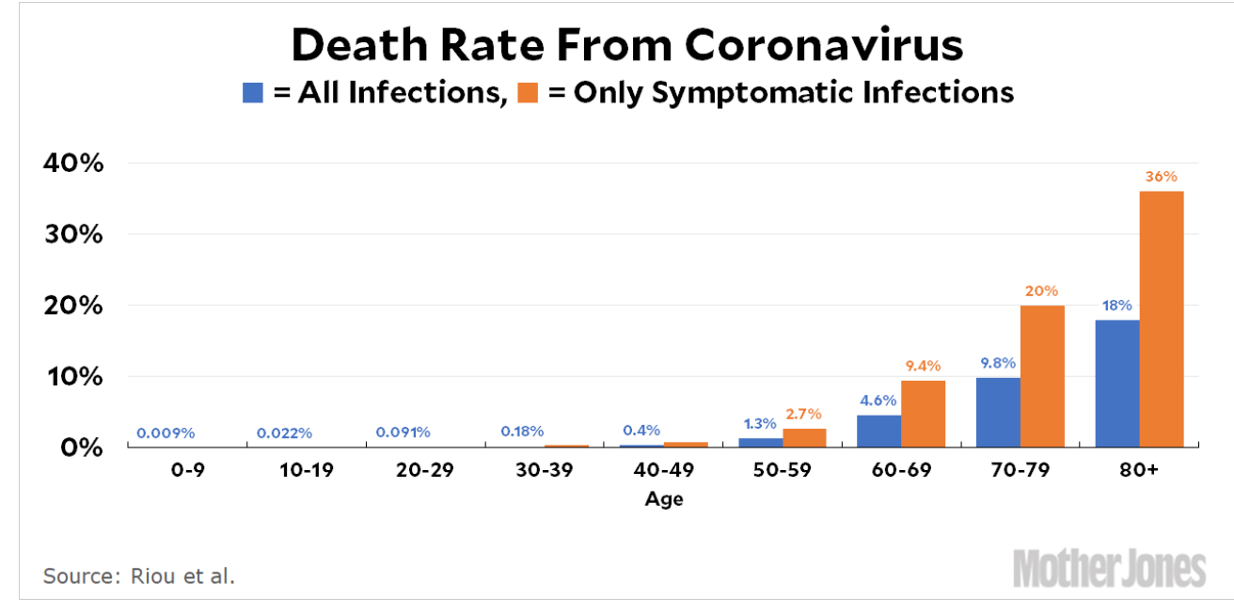
MOAR Coronavirus!
Death for Geezers!
Mortality for the Youngs very low…
It’s the flu for them—for you…
And an extra doubling—or is it 5%?—mortality for the asthmatic
And an extra doubling—or is it 5%?—mortality for the overweight

Slide 40
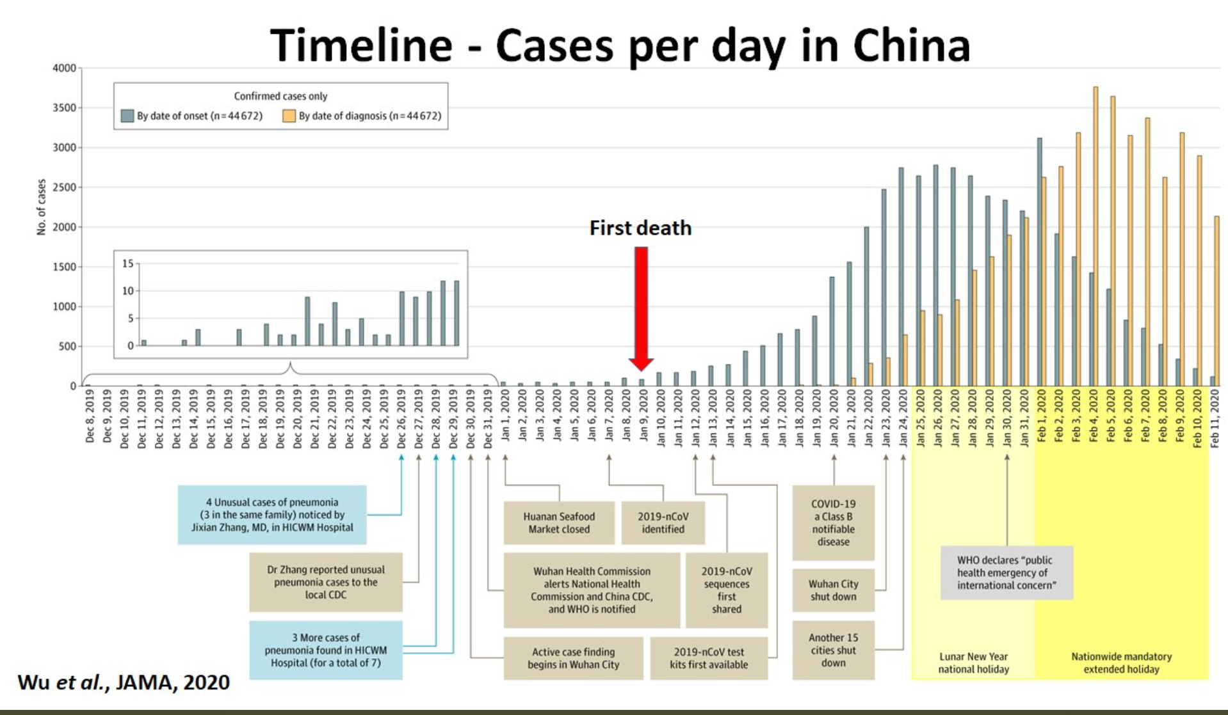
What We Think Happened in Wuhan
China beat it quickly & relatively easily!
We think
Shut down Wuhan when 200 cases per day
That seems to have been a good decision

Slide 41

The Goal
When Is It Appropriate to Move on This?
Immediate social distancing…
Self-isolate if you have a cough and a fever…
Hope that warmer temperatures will do to this what they did to SARS…
Otherwise, when do you want to start spreading out transmission. It seems that early is as good as later, so do it early…
I have no good intuition on why you want to move early
Plus your moving early will be wasted if you get reinfected
Plus the sparks you throw off making others’ lives more difficult

Slide 42
References
Financial Times (2020): Coronavirus Tracked: The Latest Figures as the Pandemic Spreads <https://www.ft.com/coronavirus-latest>
Nick Rowe (2020): Relative Supply Shocks, Unobtainium, Walras' Law, and the Coronavirus <https://worthwhile.typepad.com/worthwhile_canadian_initi/2020/03/relative-supply-shocks-unobtainium-walras-law-and-the-coronavirus.html>
Jim Stock (2020): Coronavirus Data Gaps and the Policy Response <https://drive.google.com/file/d/12MV466ZZy5xHir4xdPhoTrL1oO8CbZU-/view>

Slide 43
MOAR Coronavirus!
What I am watching:
Max Roser & Hannah Ritchie: Coronavirus Disease (COVID-19) <https://ourworldindata.org/coronavirus>…
Worldometer: Coronavirus Update (Live) <https://www.worldometers.info/coronavirus/>: ‘125,599 Cases and 4,605 Deaths from COVID-19 Virus Outbreak…
FT Coronavirus Tracker <https://www.ft.com/content/a26fbf7e-48f8-11ea-aeb3-955839e06441>
Josh Marshall’s COVID Twitter List <https://twitter.com/i/lists/1233998285779632128>
NEJM Group: Updates on the Covid-19 Pandemic <http://m.n.nejm.org/nl/jsp/m.jsp?c=%40kxNtXckRDOq8oG0jJvAXsIzN4mPECIPhltxoTSdTU9k%3D&cid=DM89089_NEJM_COVID-19_Newsletter&bid=173498255>: 'From the New England Journal of Medicine, NEJM Journal Watch, NEJM Catalyst, and other trusted sources...

Slide 44
Catch Our Breath…
Ask a couple of questions?
Make a couple of comments?
Any more readings to recommend?
<https://www.icloud.com/keynote/0YKEi7HeOrVGvKYtt9FEqH7nA>
<https://www.bradford-delong.com/2020/04/coronavirus.html>
github:<https://github.com/braddelong/public-files/blob/master/coronavirus.pptx>
https://github.com/braddelong/public-files/blob/master/coronavirus.pdf>
html File: <https://www.bradford-delong.com/2020/04/coronavirus.html>
Edit This File: <https://www.typepad.com/site/blogs/6a00e551f08003883400e551f080068834/post/6a00e551f080038834025d9b3bd66a200c/edit>
<https://delong.typepad.com/files/2020-04-01-coronavirus.pdf>

Slide 45
Coronavirus! (March 16)
With 31 deaths in the U.S. as of March 11, a 1% death rate, and up to 4 weeks between infection and death, that means that as of Feb 12 there were 3100 coronavirus cases in the United States.
With 87 deaths in the U.S. as of Mar 16, a 1% death rate, and up to 4 weeks between infection and death, that means that as of Feb 17 there were 8700 coronavirus cases in the United States
If it is doubling every seven days, then now about 150,000 people have and in the next week about 150,000 more people in the U.S. will catch coronavirus—which means 1/2200, currently 3500 of the 7.6 million inhabitants of San Francisco Bay. Touch a hard surface that any of those 3500 has touched in the last 48 hours, and the virus has a chance to jump to you…
These numbers could be five times too big. These numbers are probably not five times too small unless the thing is a lot less deadly, and there are a lot of asymptomatic cases…
What is wrong with this analysis?

Slide 46

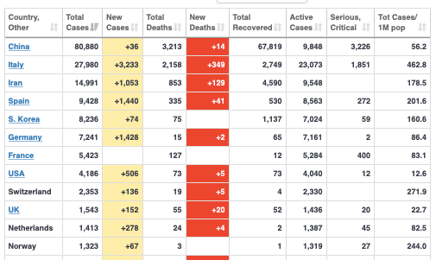
MOAR Coronavirus!
As of March 21: Things are not moving in the right direction:
What is the R0?
How can the R0 be changed?
How will the R0 change?
What is the asymptote share of the population?
What is the mortality rate?

Slide 47
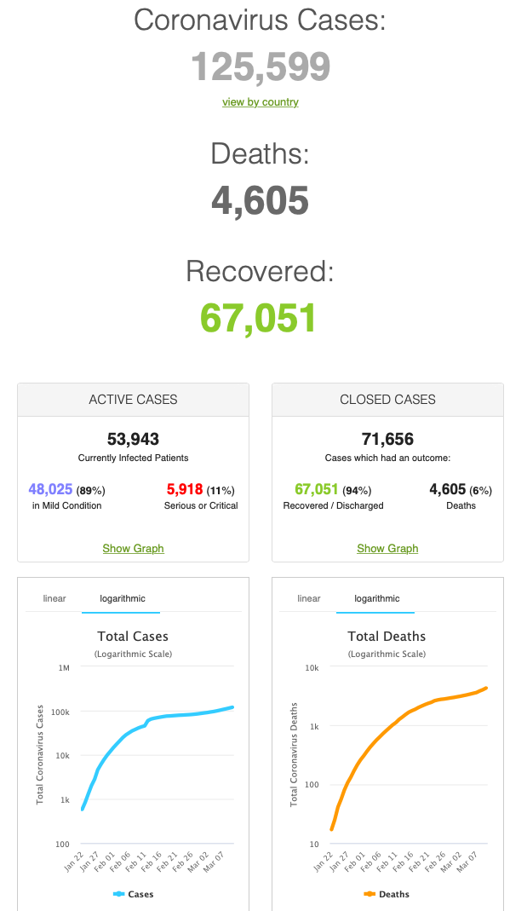
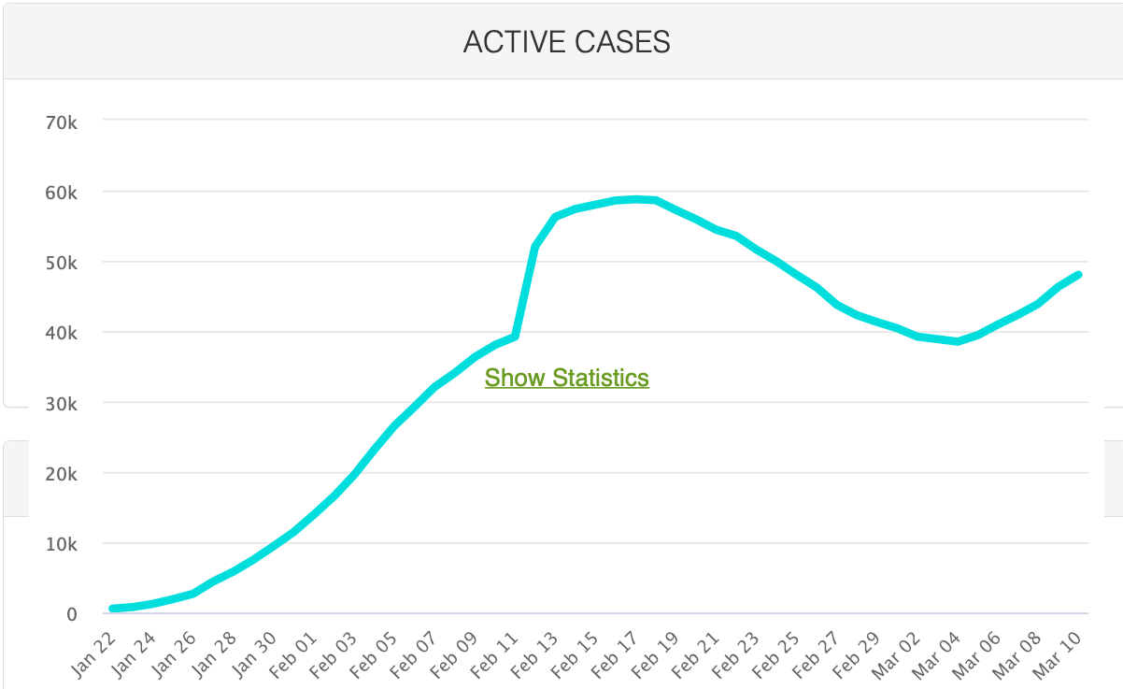
MOAR Coronavirus!
As of March 10: Things are not moving in the right direction:
What is the R0?
How can the R0 be changed?
How will the R0 change?
What is the asymptote share of the population?
What is the mortality rate?

Slide 48
Notes

